Slide 1
Chapter 4-2 Clustering
Dr. Dai Yu

Slide 2
Clustering
Clustering is to group a set of documents with high similarity
Documents in a cluster are similar
Documents in different clusters are not similar
Un-supervised Learning.
data needs not to be labeled

Slide 3
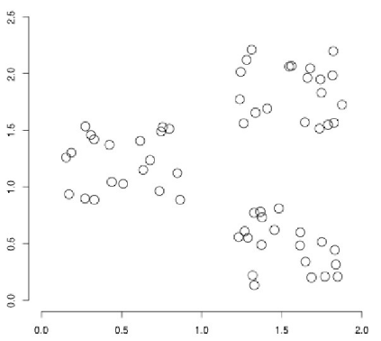
Example

Slide 4
Classification VS Clustering
Classification: supervised learning
label is predefined
Clustering: un-supervised learning
need no intervene from human beings
but affected by many factors: the number of the clusters, methods for computing similarity degree, the way to express the document

Slide 5
Clustering in IR
Assumption:
Documents in the same cluster are similar.
Application in IR
Retrieval based on clustering--> speed up the process
visualization based on clustering-->tell the user what is the most concerned keywords
Probe retrieval based on clustering-->headline

Slide 6
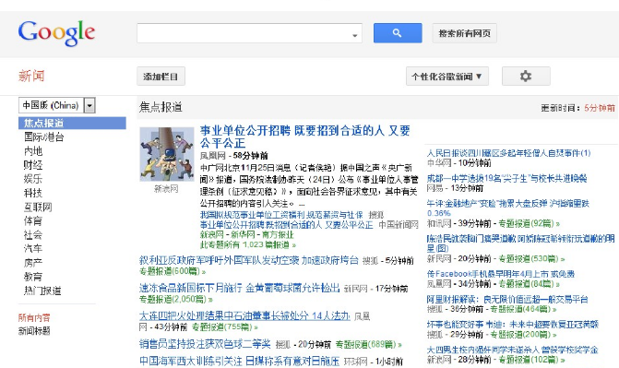
Example

Slide 7
Improve Recall
Clustering the doucments
when the doucment d is matched with the query, return the other documents which are in the cluster of d
Then, when the document containing “car” is returned, then, the document containing “automobile” will be returned also.

Slide 8
How to find the clusters

Slide 9
Aim of the clustering
Aim:
group the similar documents into a cluster, while group not similar documents into different clusters
how to formlize the problem?
The number of the clusters should be appropriate
how to set this number?
avoid too large and too small cluster

Slide 10
Flat Clustering VS Hierachical Clustering
Flat clustering
Group all or part of the documents
Modification with multiple iteration
Example: K-means clustering algorithm
Hierachical Clustering
Construct the clusters with hierachical structure

Slide 11
Flat Clustering
The aim is to Group N documents into K clusters
Given a set of documents and the number of the clusters k
The algorithm will find the optimal partition of the set in order to make the documents with high similarity with the one in the same cluster while make the documents with less similarity with the one in the other cluster.
Global optmization? Heuristic Algorithm?
K-means clustering

Slide 12
K-means Clustering
most famous one
simple and better result
default algorithm for clustering the doucments

Slide 13
How to express the document?
Vector Space Model
How to compute the similarity degree between the documents?
Euclidean distance
similiar to the cosine distance when the length of the two vectors are the same
normalization can be used

Slide 14

K-Means Clustering Algorithm
Compute the vector of the centroid for each cluster
w is a cluster
Partition: to make the document with the shortest distance with the centroid.
Step:
re-assignment: assign the document to the cluster which is close to it.
re-computation: compute the centroid

Slide 15
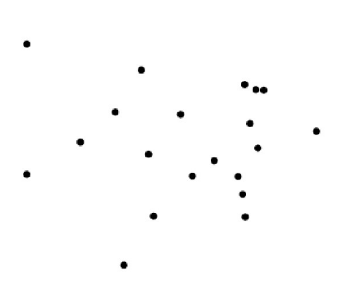
Example

Slide 16
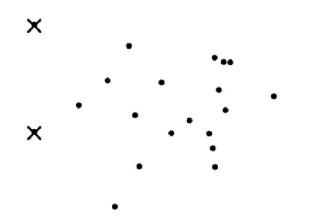
Example
Random select 2 seeds (K=2)

Slide 17
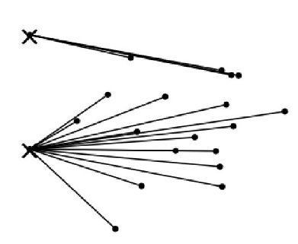
Example
Assign the documents to the centroid close to it.

Slide 18
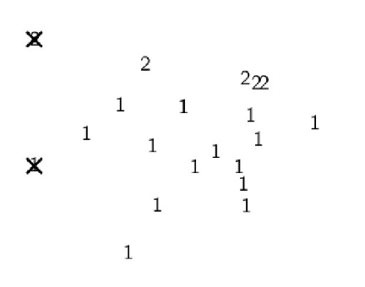
Example
The first iteration

Slide 19
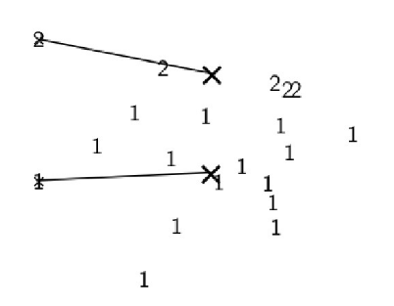
Example
Re-compute

Slide 20
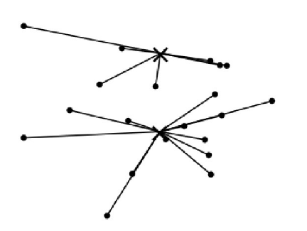
Example
Re-assignment

Slide 21
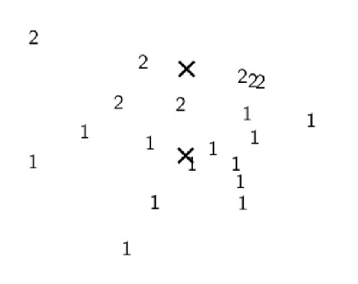
Example
Result

Slide 22
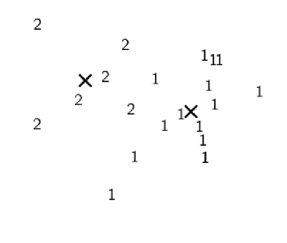
Example
Final Example

Slide 23
K-means clustering is covergent
But donot know the time to be convergent
The number of the iterations may be very big.
The result is affected by
the seeds

Slide 24
Initialization of K-means
The selection of the seeds
Filter out some outlier

Slide 25
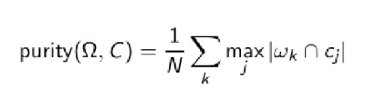

How to evaluate the clustering result
Internal criteria
Evaluate RSS
RSS is the sum of the distance between each document to the centroid in the same cluster.
External criteria
Evaluate the algorithm with a pre-taged data set
Purity
is the set of the clusters. C is the set of the class. For each cluster wk, find a class cj which contains the most data points in wk.

Slide 26
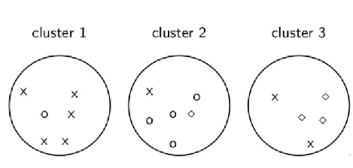


Example

Slide 27
Determine the number of the cluster
K is predefined always
according to the application
according to the size of the screen
Another method
try one by one
begin with K=1 to n
define a punishment function
evaluate the punishment and RSS
select appropriate K.

Slide 28
Interactively K-Means Clustering

Slide 29
Hierachical Clustering
Generate a hierachical structure
Famous Method: hierarchical agglomerative clustering, HAC

Slide 30
HAC
Initially, each document is a cluster.
Then, merge two similar clusters into one
Repeat until there is one cluster
Dendrogram is used to describe this structure.

Slide 31
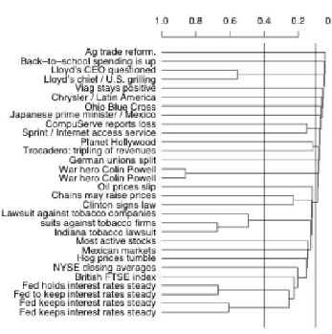
Dendrogram

Slide 32
The Key is to define similarity degree between clusters
Single-link
the maximum similarity degree between the documents in two clusters.
Complete-link
the minimum similarity degree between the documents in two clusters.
Centroid
the average similarity degree between the centroid in the two clusters.
Group-average
the average similarity degree between all the documents in the clusters which also include the similarity between the documents in the same cluster.

Slide 33
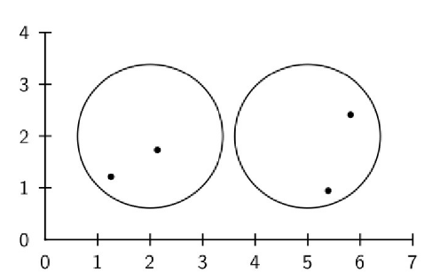
Example--Single link(shortest distance)

Slide 34
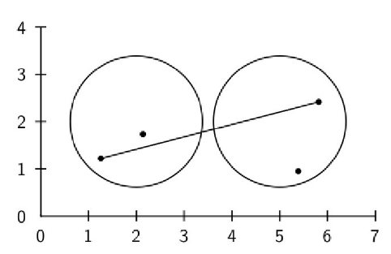
Complete link: longest distance

Slide 35
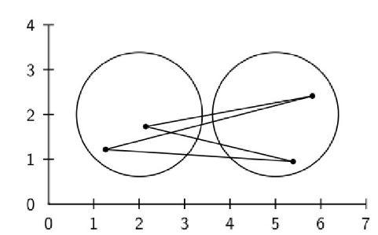
Centroid

Slide 36
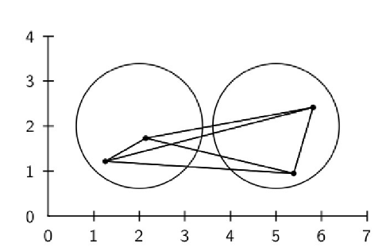
Group-average

Slide 37
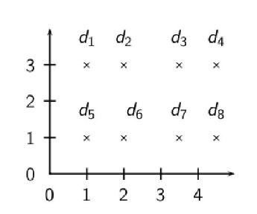
How to Use single link and complete link

Slide 38
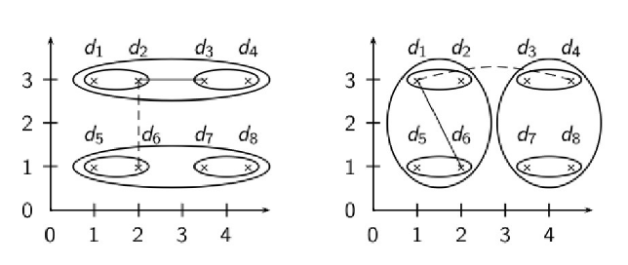
Result

Slide 39
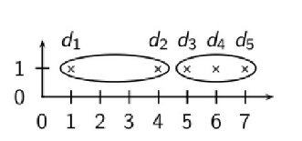
Result Analysis
Single link always generate a long and mess cluster.
Complete link is sensitive to the outlier
it seperates d2 with the right neighbor.
because there exists the outlier d1

Slide 40
Centroid
Evaluate the similarity degree between the two clusters as the average of the similarity degree between each pair of the documents
Just as to evaluate the similarity degree between two centroids in the clusters

Slide 41
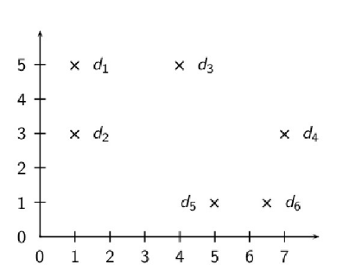
Example

Slide 42
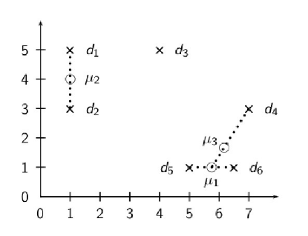
Example

Slide 43
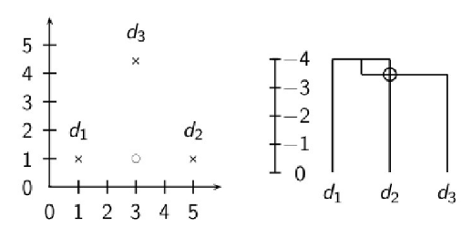
Inversion of the similarity degree

Slide 44
Group-average
Compute the similarity degree of all the documents
Not cause inversion

Slide 45
How to choose?
Centroid->if donot consider inversion
group average->not limit to chaining and outlier
group average uses vector to express a document
other expression, e.g. only know the similarity degree between a pair of documents, can use complete link.
However, some application can use sigle-line.
Repeatability detection

Slide 46
Flat or Hierachical Clustering
To achieve effectiveness, use flat clustering
If cannot determine K, use hierachical clustering.
If needs hierachical structure, use hierachical clustering.

Slide 47
How to generate clustering labels
give a meaning description for the clusters
Consider the difference between different clusters
feature selection
As for the clustering of the documents, title of the documents can be used.

Slide 48
Supervised Classfication & un-Supervised Clustering
Unsupervised clustering
group similar objects together to find clusters
Minimize intra-class distance
Maximize inter-class distance
Supervised classification
class label for each training sample is given
Build a model from the training data
Predic class label on unseen future data point

Slide 49
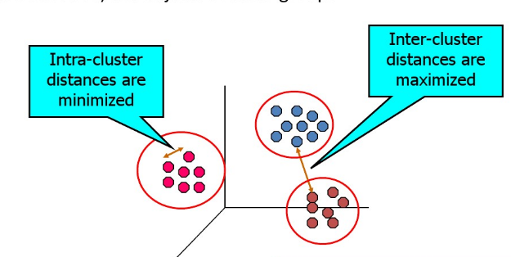
What is Clustering?
Finding groups of objects such that objects in a group will be similar to one another and different from the objects in other groups

Slide 50
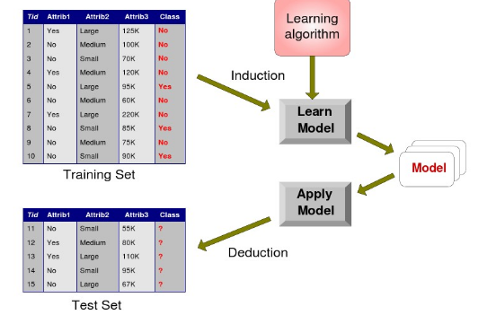
What is Classification?

Slide 51
Clustering Algorithm
K-Means
Hierarchical Clustering

Slide 52
Classification Algorithm
Regression
Bayesian
Decision Tree
K-Nearest-Neighbor Classification
Neural Networks

Slide 53
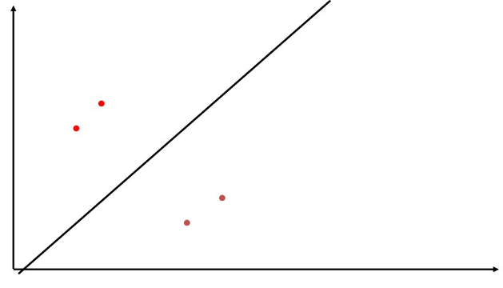
Supervised Classification

Slide 54
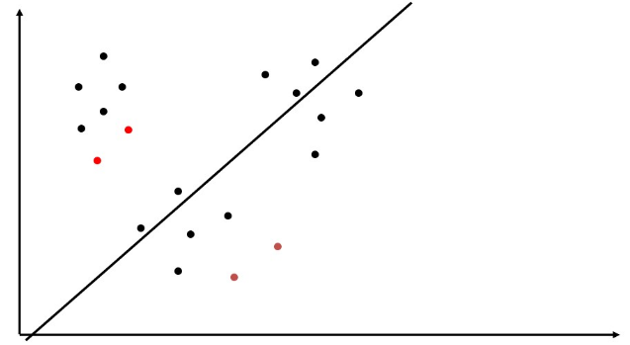
Supervised Classifcation

Slide 55
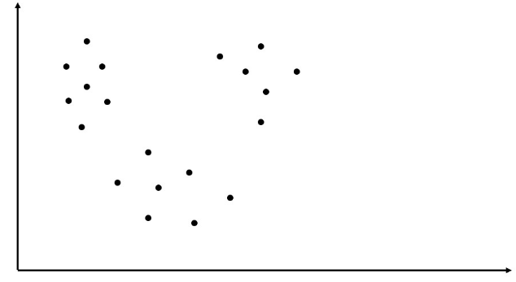
Unsupervised Classification

Slide 56
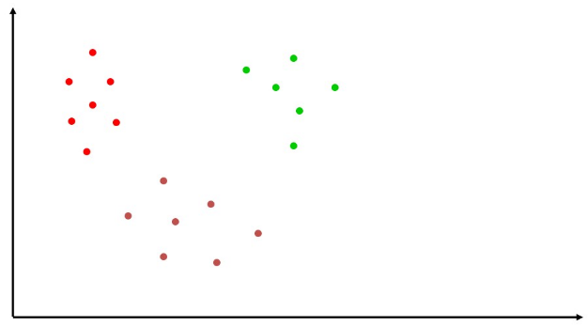
Unsupervised Clustering

Slide 57
Semi-Supervised Learning
Combines labeled and unlabeled data during training to improve performance
semi-supervised classification: training on labeled data, exploirts additional unlabeled data
semi-supervised clustering: uses small amount of labeled data to aid and bias the clustering of the unlabeled data.

Slide 58
Semi-supervised classification example

Slide 59
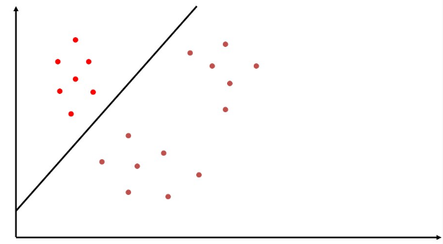
Semi-supervised classification example

Slide 60
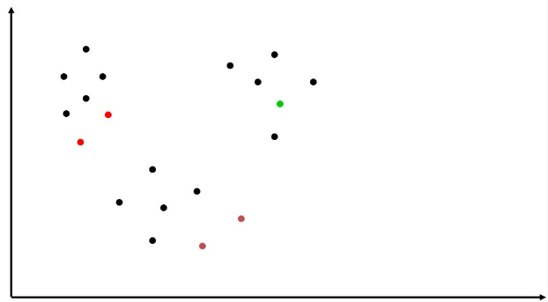
Semi-supervised clustering example

Slide 61
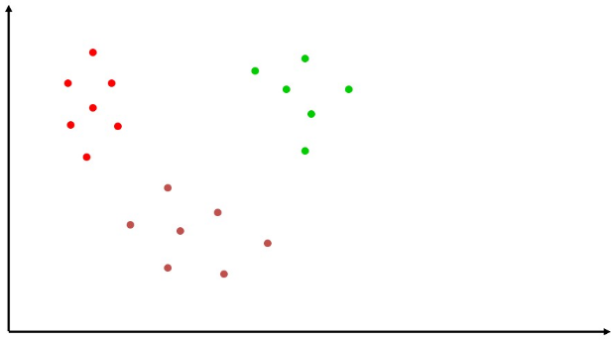
Semi-Supervised Clustering Example

Slide 62
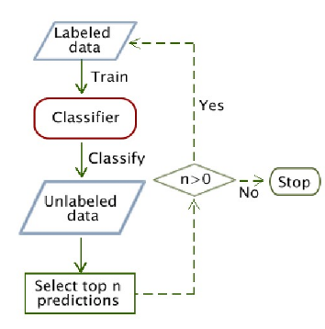
semi-supervised classification

